Slide 1
Gift Bag Design Log
By Mr Graham

Slide 2
Requirements
be created using only vector tools
have sides and a base
show the scale and dimensions
show where the bag will be folded when it is assembled
show any areas which will be glued
show what type of handle the bag will have and how it will be attached
include your logo and the text 'On your marks!'
include another visual link to the running vest

Slide 3
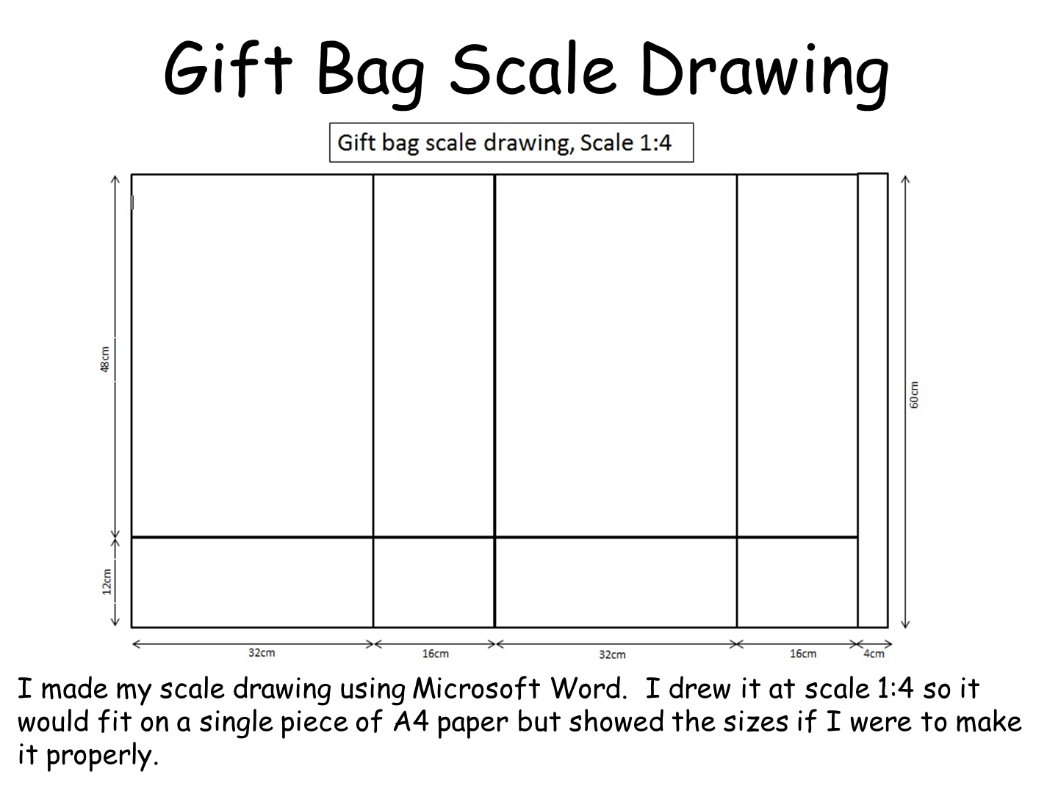

Slide 4
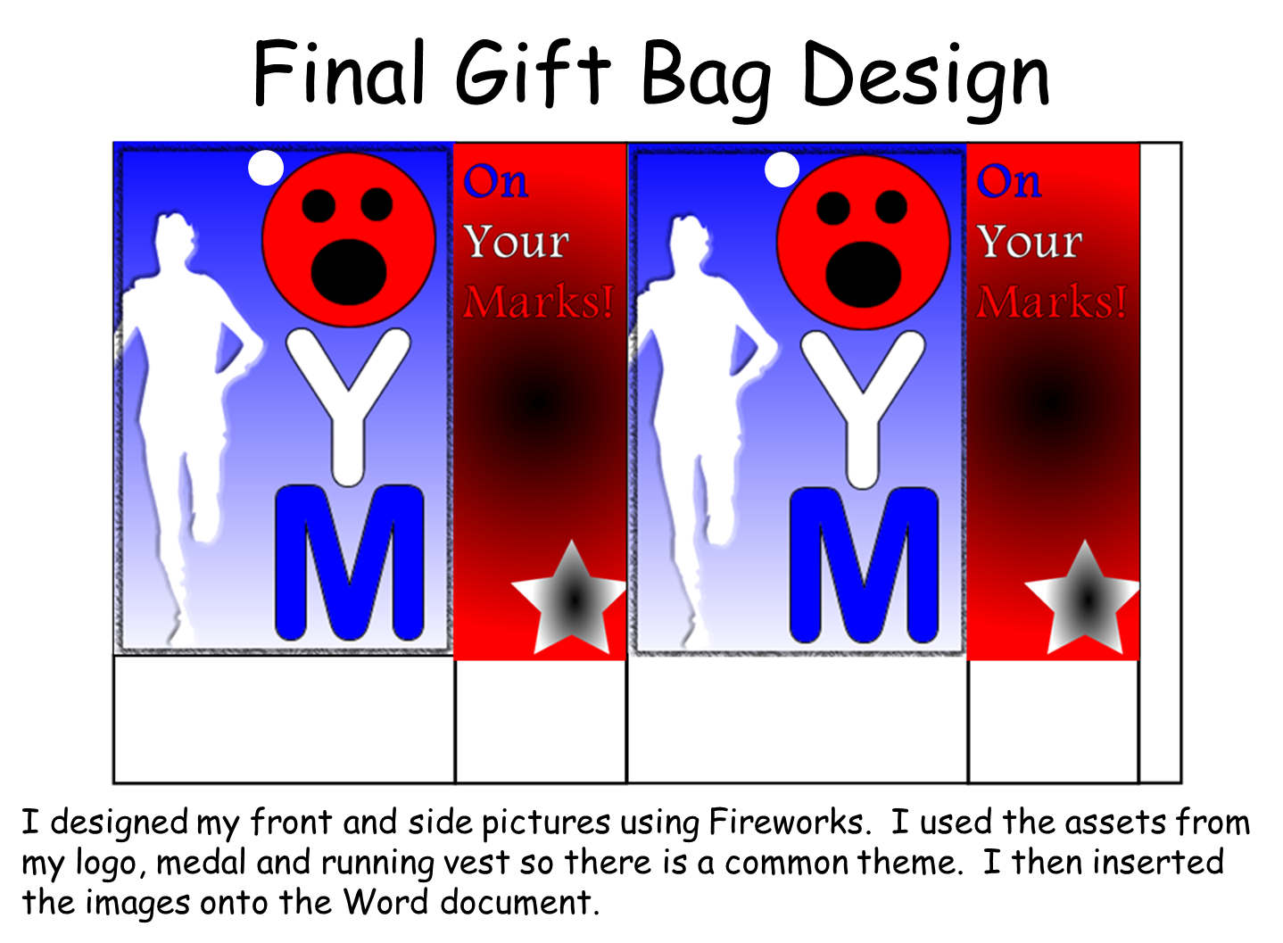

Slide 5
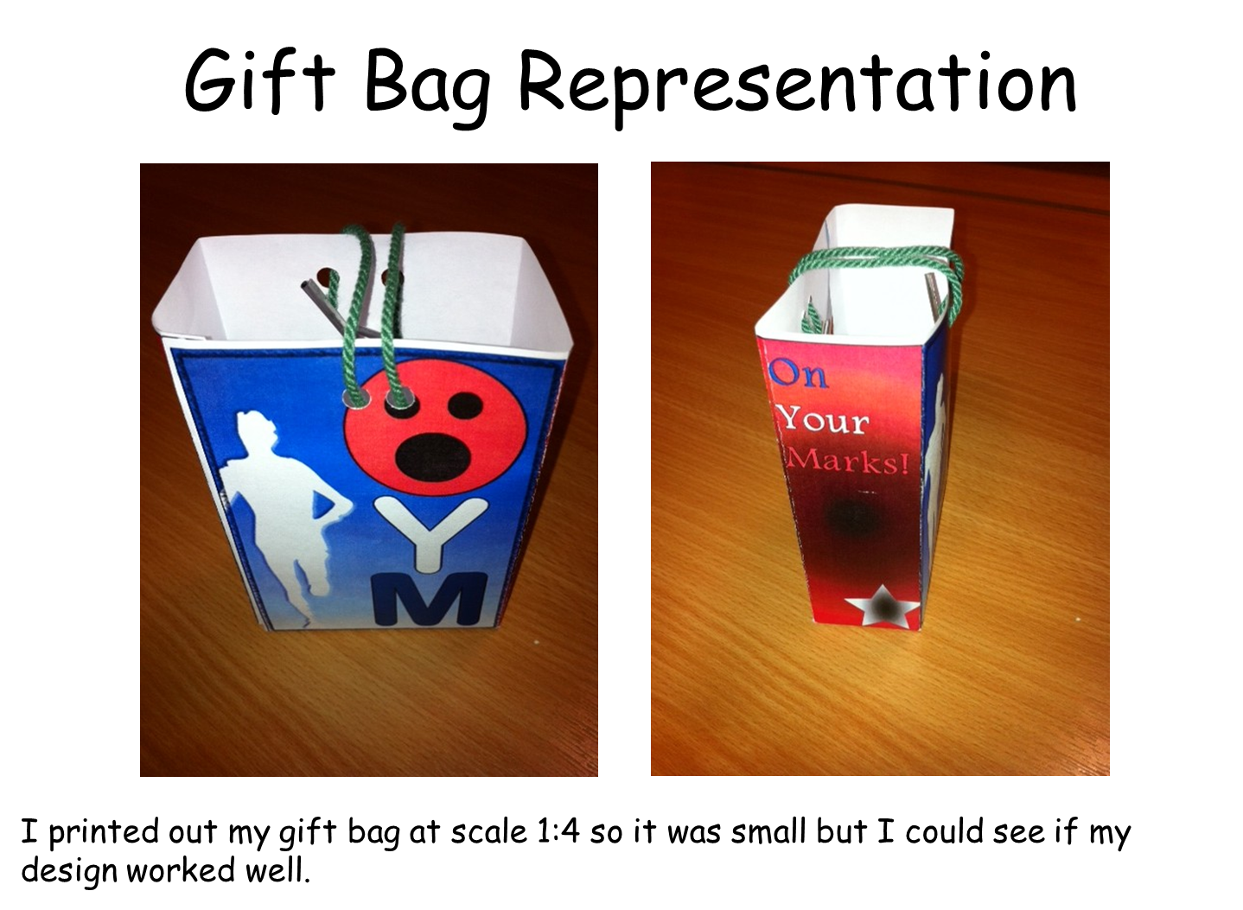

Slide 6
